Slide 1
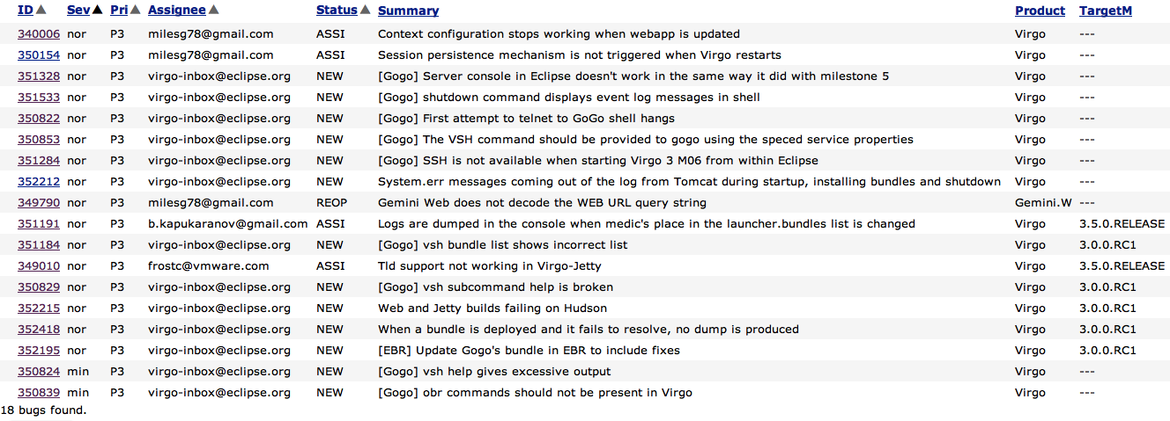
Bug Triage

Slide 2
Release Schedule – plan B
Deadline | Work Item
25 July | Resolve CQ4354
25 July | Submit IP log
25 July | Obtain PMC approval
25 July | Submit docuware
3 August | Review starts*
10 August | Review completes
11 August | Build release
12 August | Publicise release
* Glyn on vacation 6-21 August

Slide 3
Release Schedule – plan A
Deadline | Work Item
3 August | Resolve CQ4354
3 August | Submit IP log
10 August | Obtain PMC approval
10 August | Submit docuware
17 August | Review starts*
24 August | Review completes
25 August | Build release
26 August | Publicise release
* Glyn on vacation 6-21 August

